Slide 1
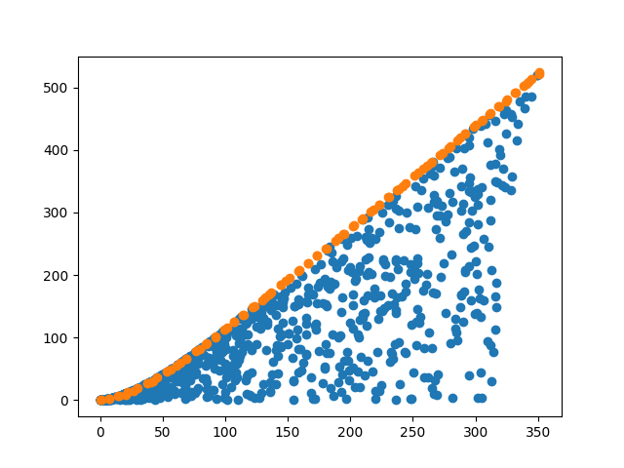
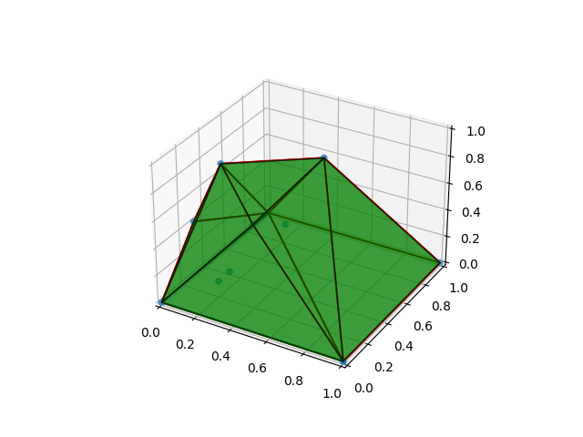
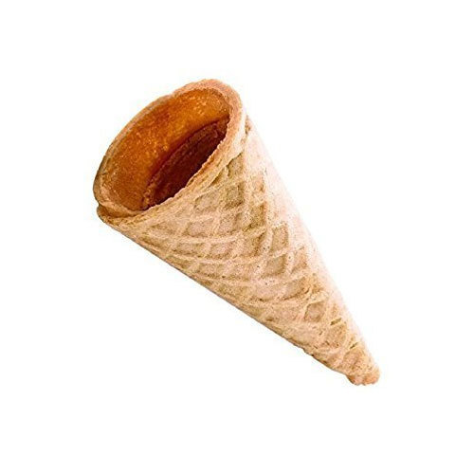
Afternoon program
Parallel coordinates
1 solution
V(r,h)->max (minimize –V(r,h))
f1 f2 f3 f4
better
Work on the completion of Desdeo Example for cone/tin objective
check out: git: Day03 Notebook and scripts desdeo-test-problem-and-Pareto-plot.py
Compute a Pareto front for Tent design:
→ 2 objectives: volume/surface (constant floor sidelength 1)
→ 3 objectives: two bar truss (exclude buckling stress)
→ 4 objectives: height, floor, surface, volume
Use 15 point designs in all cases to produce the Pareto front
Visualize some solutions on the Pareto front (for the report)
Send Pareto front to Bhupinder We will collect and make combined Pareto front
A(r,h)->min

